Slide 1
METRICS FOR PROJECT SIZE ESTIMATION Lines of code (LOC), Function point (FP)

Slide 2
Lines of Code (LOC)
This metric measures the size of a project by counting the number of source instructions in the developed program.
Obviously, while counting the number of source instructions, comment lines, and header lines are ignored.
Determining the LOC count at the end of a project is very simple. However, accurate estimation of LOC count at the beginning of a project is a very difficult task.
The project manager divides the problem into modules, and each module into sub-modules and so on, until the LOC of the leaf-level modules are small enough to be predicted
However, to be able to predict the LOC count for the various leaf-level modules sufficiently accurately, past experience in developing similar mo dules is very helpful

Slide 3
Shortcomings of the LOC metric
LOC is a measure of coding activity alone. A good problem size measure should consider the total effort needed to carry out various life cycle activities (i.e. specification, design, code, test, etc.) and not just the coding effort.
LOC gives a numerical value of problem size that can vary widely with coding styles of individual programmers. By coding style, we mean the choice of code layout, the choice of the instructions in writing the program, and the specific algorithms used. Different programmers may lay out their code in very different ways.
Larger code size does not necessarily imply better quality of code or higher efficiency. Some programmers produce lengthy and complicated code as they do not make effective use of the available instruction set or use improper algorithms.
It is very difficult to accurately estimate LOC of the final program from problem specification

Slide 4
Function Point (FP) Metric
This metric overcomes many of the shortcomings of the LOC metric.
One of the important advantages of the function point metric over the LOC metric is that it can easily be computed from the problem specification itself:
The idea is: The size of a software product is directly dependent on the number of different high-level functions or features it supports. Conceptually, the function point metric is based on the idea that a software product supporting many features would certainly be of larger size than a product with less number of features.
For example, in a banking software, a function to display a help message may be much easier to develop compared to say the function that carries out the actual banking transactions
This has been considered by the function point metric by counting the number of input and output data items and the number of files accessed by the function. Each feature when invoked typically reads some input data and then transforms those to the required output data
the computation of the number of input and output data items would give a more accurate indication of the code size compared to simply counting the number of high-level functions supported by the system.

Slide 5
Function Point (FP) Metric
Function Points (FP) is indirect approach method where instead of focusing on the function it focuses on the domain characteristics.
Focus on program "functionality" or "utility“.
Five information domain characteristics are determined and counts for each are provided and recorded in a table:
Measurements Parameters | Examples
Number of External Inputs(EI) | Input screen and tables
Number of External Output (EO) | Output screens and reports
Number of external inquiries (EQ) | Prompts and interrupts.
Number of internal files (ILF) | Databases and directories
Number of external interfaces (EIF) | Shared databases and shared routines.

Slide 6
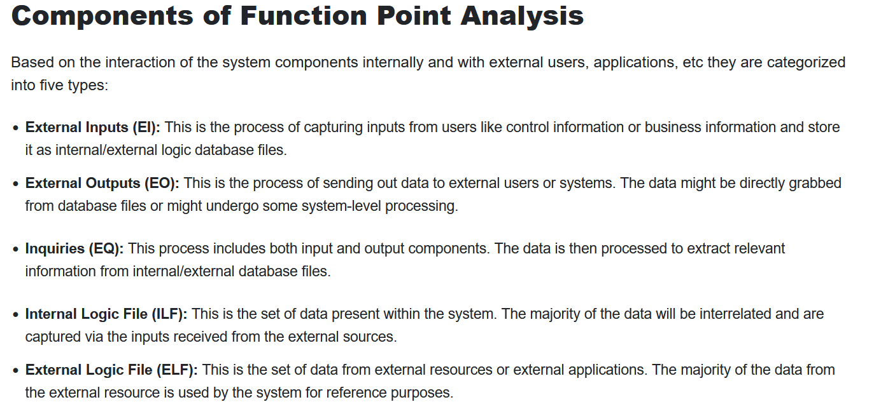

Slide 7
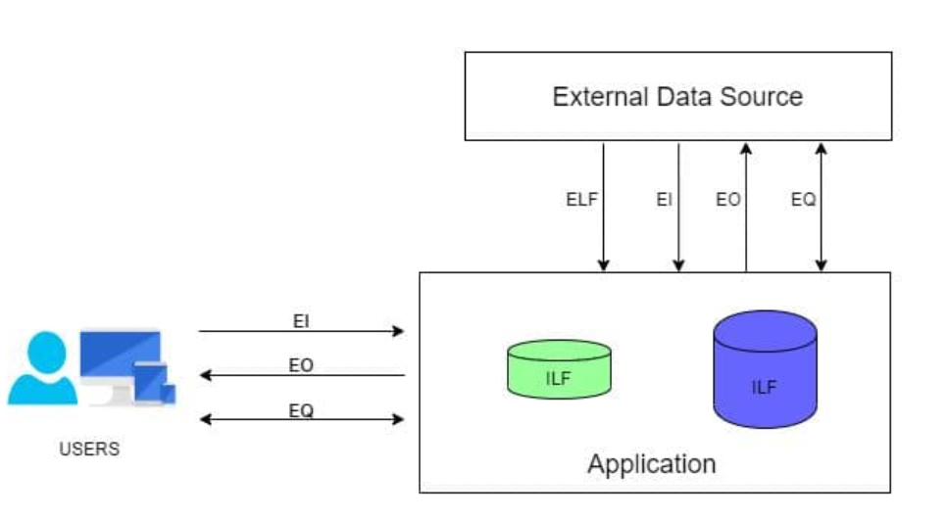

Slide 8
Function point (FP) metric computation
Depending upon these complexity values is calculated.
To compute function points, we use:
FP = UFP * [ 0.65 + 0.01 * SUM(degree of influence) ]

Slide 9
Step 1: UFP computation
The unadjusted function points (UFP) is computed as the weighted sum of five characteristics of a product as shown in the following expression. The weights associated with the five characteristics were determined empirically by Albrecht through data gathered from many projects.
Measurement Parameter | Low | Average | High
1. Number of external inputs (EI) | 7 | 10 | 15
2. Number of external outputs (EO) | 5 | 7 | 10
3. Number of external inquiries (EQ) | 3 | 4 | 6
4. Number of internal files (ILF) | 4 | 5 | 7
5. Number of external interfaces (EIF) | 3 | 4 | 6

Slide 10
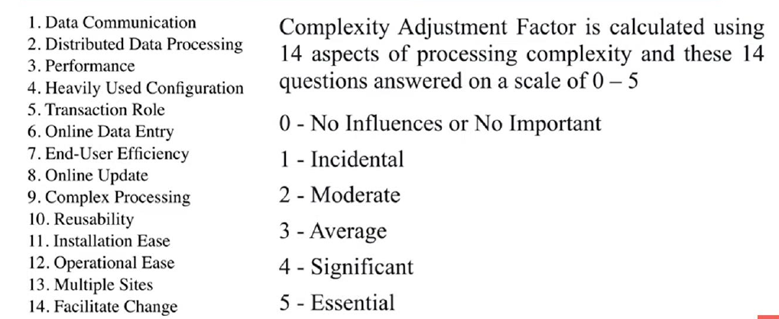
complexity adjustment Factors

Slide 11
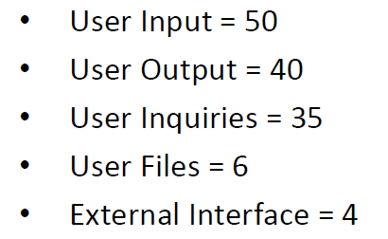
Example
Given the following values, compute function point when all complexity adjustment factor (CAF) and weighting factors are average.

Slide 12
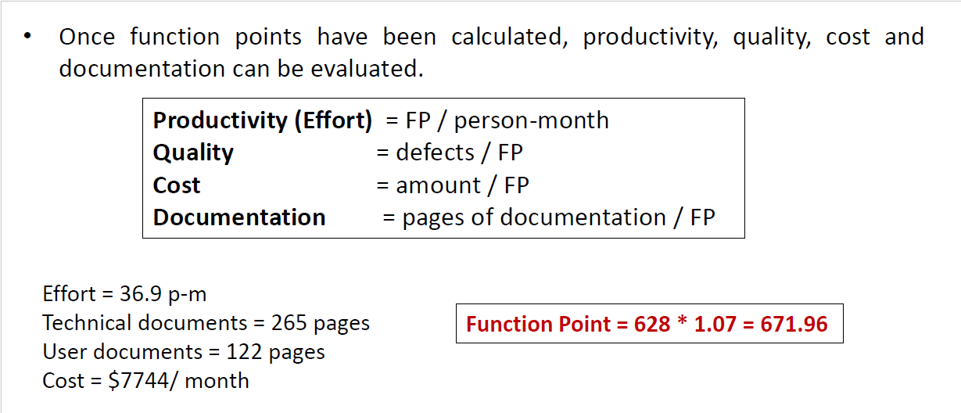

Slide 13
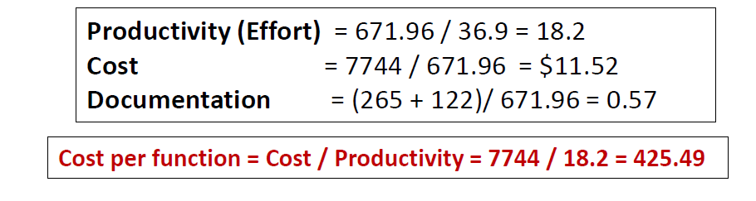
Final answers

Slide 14
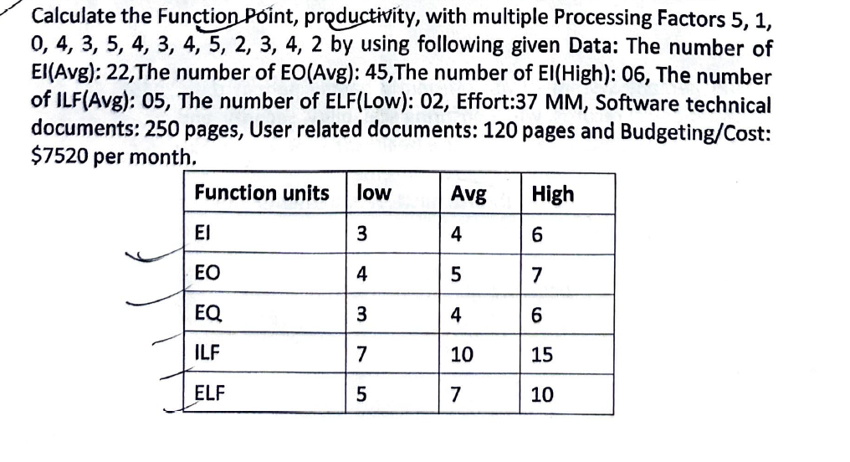
Problem 1:

